Slide 1
The Inside Track to Proposed Rules for Implementation of the America Invents Act
NJIPLA Meeting
Trenton Marriott
February 7, 2012

Slide 2
PROPOSED RULES FOR POST GRANT, Inter partes & Transitional (BMP) Proceedings

Slide 3
DELAYED!!!!!
(Watch this space on February 8, 2012)

Slide 4
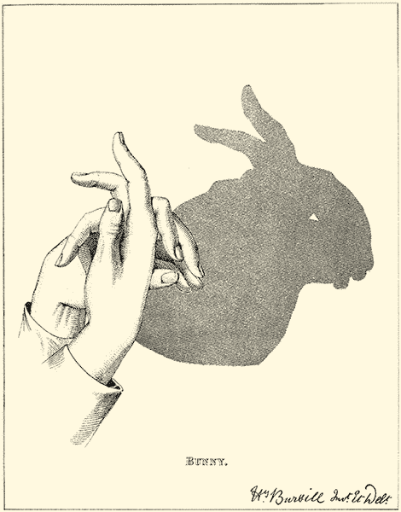

Slide 5
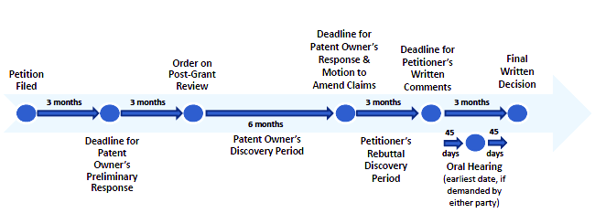
Post Grant Rules Package: What to Look For…..A Timeline

Slide 6
Post Grant Rules Package: What to Look For Attention to Due Process
“Patents . . . have long been considered a species of property. See Brown v. Duchesne, 19 How. 183, 197, 15 L.Ed. 595 (1856) (“For, by the laws of the United States, the rights of a party under a patent are his private property”); cf., Consolidated Fruit-Jar Co. v. Wright, 94 U.S. 92, 96, 24 L.Ed. 68 (1876) (“A patent for an invention is as much property as a patent for land”). As such, they are surely included within the ‘property’ of which no person may be deprived by a State without due process of law.” Florida Prepaid Postsecondary Educ. Expense Bd. v. College Savings Bank, 527 U.S. 627, 642 (1999).
For Patent Owners, participation in post grant proceedings is always involuntary, even to the point of denying having the issues resolved in court before a jury

Slide 7
Post Grant Rules Package: What to Look For Front Loaded & Fairly Priced
“Among the reforms that are expected to expedite these proceedings are the shift from an examinational to an adjudicative model, and the elevated threshold for instituting proceedings. The elevated threshold will require challengers to front load their case...” Floor Comments of Senator Kyl at 157 Cong. Rec. S1368, S1376 (daily ed. March 8, 2011)
‘‘the petition [must] identif[y], in writing and with particularity, each claim challenged, the grounds on which the challenge to each claim is based, and the evidence that supports the grounds for the challenge to each claim, including….” AIA, §312(a)(3) & §322(a)(3)
Fees are likely to be as projected during Congressional debate – in the $40-50 K range – balancing access against abuse potential

Slide 8
Post Grant Rules Package: What to Look For Limited but Sufficient Pre-Institution Disclosure?
Will the Petitioner be required to make a robust initial disclosure of:
Real parties in interest and privies? (See AIA §§312(a)(2) & 322(a)(2))
Knowledgeable witnesses (other than affiants), especially where prior public uses or sales are alleged?
Facts that may tend to rebut the contentions in the petition, such as conflicting test results or contrary expert opinions?
Facts that may reasonably be expected to support patentability of the challenged claims?
Long felt need
Copying and/or derivation
Failed attempts to design around
Tribute paid by the Petitioner or its privies to the patented invention
Commercial success

Slide 9
Post Grant Rules Package: What to Look For Wide Latitude For PO’s Preliminary Response - Uniform Institution Criteria
‘‘If [a petition is filed] , the patent owner shall have the right to file a preliminary response to the petition, within a time period set by the Director, that sets forth reasons why no … review should be instituted based upon the failure of the petition to meet any requirement of this chapter.” AIA 313 & 323.
Uniform Thresholds, Notwithstanding Different AIA Wording:
Inter Partes THRESHOLD.—The Director may not authorize an inter partes review to be instituted unless the Director determines that the information presented in the petition filed under section 311 and any response filed under section 313 shows that there is a reasonable likelihood that the petitioner would prevail with respect to at least 1 of the claims challenged in the petition.
Post-Grant THRESHOLD.—The Director may not authorize a post-grant review to be instituted unless the Director determines that the information presented in the petition filed under section 321, if such information is not rebutted, would demonstrate that it is more likely than not that at least 1 of the claims challenged in the petition is unpatentable.

Slide 10
Post Grant Rules Package: What to Look For But just meeting the threshold will not always be enough…
Reasons to Decline the Petition. The Director may decline to consider the petition or decide not to institute a post-grant review [AIA §326(a)(2)] if it:
(1) Fails to meet requirements [AIA §§312(a) & 322(a)]
(2) Exceeds the Director’s limit [AIA §329(F)(2)(A)]
(3) Already involved in another proceeding [AIA §315(a), (b) & (d); §325(d) (first sentence)]
(4) Involves the same or substantially the same prior art or arguments previously considered, or that could previously have been raised [AIA §325(D) (second sentence) & estoppel under §315(e)(1) & §325(e)(1)]
(5) Denial is favored by economy, the integrity of the patent system, the efficient administration of the Office, or the ability of the Office to timely complete proceedings instituted under this chapter [AIA §316(b) & §326(b)];
(6) Institution of the review would not be in the interests of justice or due process [AIA §326(a)(2); Fifth Amendment of US Constitution]; and
(7) The Covered Business Method Patent is not eligible. [AIA Sec. 18(d)] [See 157 Cong. Rec. §1368, §1376-77]

Slide 11
Post Grant Rules Package: What to Look For The Director has broad discretion to stay, transfer, consolidate or terminate petitions & proceedings:
“…the Director shall consider the effect of any such regulation on the economy, the integrity of the patent system, the efficient administration of the Office, and the ability of the Office to timely complete proceedings.” AIA §316(b) & §326(b)
“…if another proceeding or matter involving the patent is before the Office, the Director may determine the manner in which the post-grant review or other proceeding or matter may proceed, including providing for the stay, transfer, consolidation, or termination of any such matter or proceeding. In determining whether to institute or order a proceeding under this chapter, chapter 30, or chapter 31, the Director may take into account whether, and reject the petition or request because, the same or substantially the same prior art or arguments previously were presented to the Office.” AIA §325(d).

Slide 12
Post Grant Rules Package: What to Look For Threshold Showings Will Define The Scope of The Proceedings
“Also, by requiring petitioners to tie their challenges to particular validity arguments against particular claims, the new threshold will prevent challenges from ‘mushrooming’ after the review is instituted into additional arguments employing other prior art or attacking other claims.” Floor Comments of Senator Kyl at 157 Cong. Rec. S1368, S1376 (daily ed. March 8, 2011)
If [a] … review is instituted and not dismissed under this Chapter, the Patent Trial and Appeal Board shall issue a final written decision with respect to the patentability of any patent claim challenged by the petitioner and any new claim added under section 316(d). AIA, §318(a); §328(a).

Slide 13
Post Grant Rules Package: What to Look For Discovery Will be Phased… and Include Board Involvement
Likely to be at least two discovery periods, managed by a presiding judge
“Standard” procedures will likely govern confidentiality and other common issues
Some “automatic” discovery is likely
Board is likely to stress informal dispute resolution over misc. motion practice
Board likely to adopt an evolving “practice guide”
Will deposition testimony be time limited?

Slide 14
Post Grant Rules Package: What to Look For PO’s Response Should Respond To All Instituted Grounds; Petitioner’s “Written Comments” Will Be Limited To PO’s Response
The Patent Owner’s Response on Post-Grant Review should include any affidavits or declarations, or additional factual evidence and expert opinions, on which the patent owner relies in support of the response [AIA §326(a)(3), (4) & (8); §326(b)].
The petitioner’s Written Comments in Support of Post-Grant Review will likely be limited to rebuttal of the Patent Owner’s Response on Post-Grant Review. AIA 326(a)(12).
The petitioner will likely be permitted to file a brief, supported by citation to evidence previously submitted to the Board by any party, and factual rebuttal and impeachment evidence adduced from the patent owner or the patent owner’s witnesses during the Petitioner’s Rebuttal Discovery Period.
No new arguments of unpatentability or additional expert testimony or opinions will likely be accepted as part of the Written Comments.

Slide 15
Post Grant Rules Package: What to Look For Claim Cancellation & Substitutions: Will be Allowed
Disclaimer (dedication) should be allowed at any time, and may serve to narrow the issues under review
Substitute claims should be allowed to be presented following the PO’s discovery of Petitioner’s witnesses
Rules and/or Board may determine the “reasonable number” issue
Decisions on reasonableness and patentability of substitute claims will likely be part of Board’s final decision AIA § 318 & § 328.

Slide 16
Post Grant Rules Package: What to Look For Final Hearings Will Decide Many Issues
If not earlier settled or dismissed, Final Written Decisions will decide the patentability of the claims subject to the proceeding, and those added during it
Ancillary issues relating to the issues will also likely be decided during or after final hearing
Other issues may also be deferred to the Board for decision
Final decisions will issue 12-18 months from institution
Reconsideration for manifest errors of fact or law will likely be permitted, but won’t be encouraged
Regulations may suggest some but not all circumstances that will constitute “good cause” for an extension beyond 12 months

Slide 17
Post Grant Rules Package: What to Look For Transitional Proceedings Will Simply Be A Form of PGR
“The transitional proceeding implemented pursuant to this subsection shall be regarded as, and shall employ the standards and procedures of, a post-grant review under chapter 32 of title 35, United States Code [subject to certain exceptions].” AIA §18(a)(1).
Special rules pertain to BMP’s eligible for PGR, and these may be the first to undergo PGR
Threshold related to the existence of a “charge of infringement” may prove difficult to administer. See AIA §18 (A)(1)(B).

Slide 18
Post Grant Rules Package: What to Look For “Technological Invention” Will (Finally) Be Defined
Per Section 18(d)(1): “Covered business method patent’’ means a patent that claims a method or corresponding apparatus for performing data processing or other operations used in the practice, administration, or management of a financial product or service, except that the term does not include patents for technological inventions.”

Slide 19
Blogosphere Buzz
The next rules proposal is rumored to be 3,000 pages long, and to require the entirety of a day’s printing of the Federal Register……
But whatever the truth is….

Slide 20
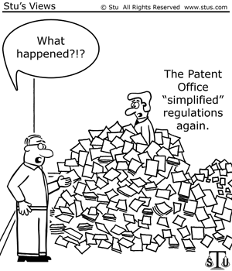
It Won’t Be Simple!!

Slide 21
Questions?

Slide 22
Thank you

Slide 23
BackGROUND SLIDES

Slide 24
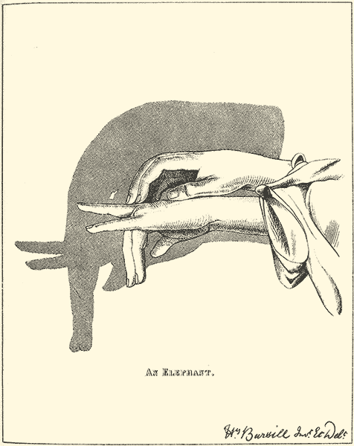

Slide 25
Taking Stock: The America Invents Act (I)
Institution of 1st Inventor-to-File system
Prior art FTF must be publically accessible – secret prior art abolished
Grace period retained, providing presumptive priority to first to publish
Derivation proceedings will protect early disclosers against others who later file on their disclosed invention
Prior user rights defense for secret “commercial uses” made more than one year prior to filing of asserted patent (includes pre-market reg. review)

Slide 26
Taking Stock: The America Invents Act (II)
Elimination of all false marking suits brought by qui tam plaintiffs – virtual marking now allowed
Elimination of best mode as a defense to patent infringement
A better funded US Patent Office
Availability of Supplemental Examination
Lessened risk of being joined, while retaining right to join ANDA filers
Small & micro-entity discounts that ensure the “little guy” retains a stake in our patent system
3rd party prior art citation during pendency allowed

Slide 27
Taking Stock: The America Invents Act (III)
All issues post-grant review
Begins within 9 months of issue – lasts 12-18 months – 3 APJ’s – Real parties in interest disclosed
Threshold: information presented, if not rebutted, demonstrates …more likely than not that a claim is unpatentable or “novel or unsettled legal question” exists that is important to other patents
Declarants may be deposed –discovery “of relevant evidence limited to evidence related to factual assertions – claims may be cancelled or substituted
Estoppel for issues that were raised or reasonably could have been raised – applies in PTO & court
Previously brought PI motion can’t be stayed
Settlement before merits decision may avoid estoppel – filed in USPTO

Slide 28
Taking Stock: The America Invents Act (IV)
Limited issues inter partes reviews:
Filed after 9 months or PGR, but limited to patents & publications – 12-18 month duration – barred after 1 yr of litigation
Threshold: reasonable likelihood petitioner will prevail on one claim
Depositions of declarants; discovery “necessary to the interests of justice”; claims may be cancelled or substituted
Estoppel for issues that were raised or reasonably could have been raised – applies in PTO & court
Settlements allowed; may avoid estoppel; file w/ PTO

Slide 29
Taking Stock: The America Invents Act (V)
Minor provisions:
No presumptions from failure to obtain or present advice of counsel information
Transitional program for business method patents but not for “technological” inventions
Limitation on “human organism” patents
Studies & satellite offices
MedicinesCo filing fix

Slide 30
Taking Stock: The America Invents Act (VI)
What is not included:
Damages provisions
Willfulness provisions
Restrictions on injunctions
Priority to defendant’s choice of forum
Statutory inequitable conduct reform
Interlocutory appeals
Repeal of “Baldwin Rule”

Slide 31
Unresolved Issues
Patentable Subject Matter
Especially for diagnostic methods & personalized medicine solutions
Experimental Use Exception
Classen case & scope of 271(e)(1)
Research tool use
Inequitable Conduct
Egregious conduct issues
USPTO rules re submission after Therasense
Extension of “super” enablement & WD requirements to small molecule PhRMA
Hostility to genus claims where not all covered compounds exemplified

Slide 32
New Frontiers
Multiple actor infringement liability:
Agency required?
Tort or contract analysis?
Infringement liability for generics whose products are used outside of their carved-out labels & use code implications (Caraco v Novo)
Remedial “technical fix” legislation for AIA

